Slide 1
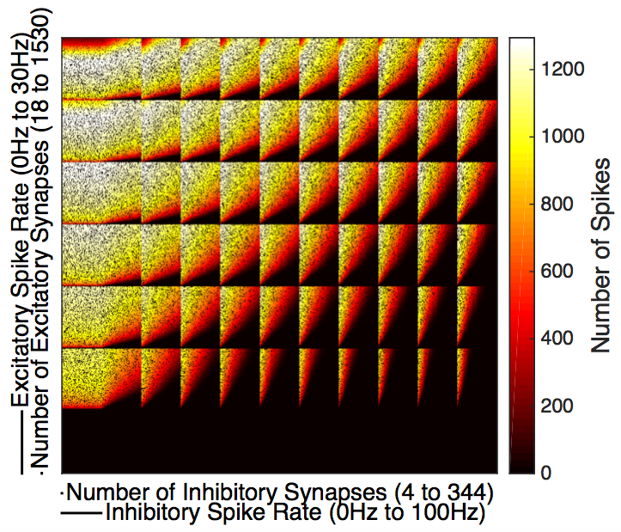



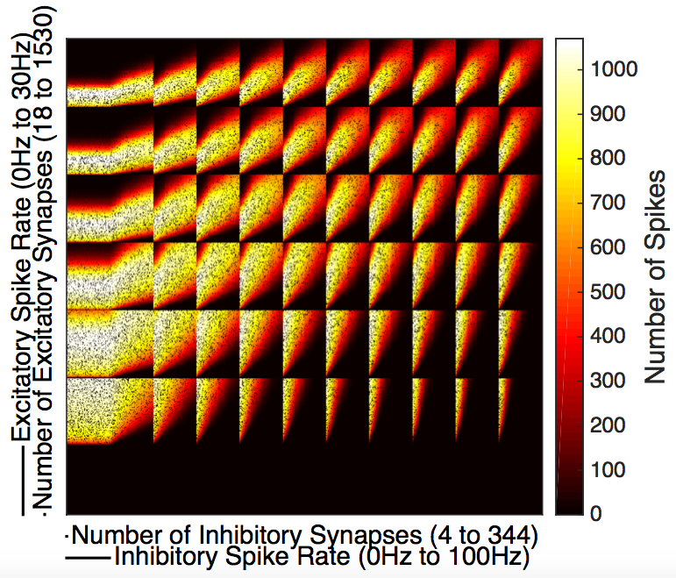
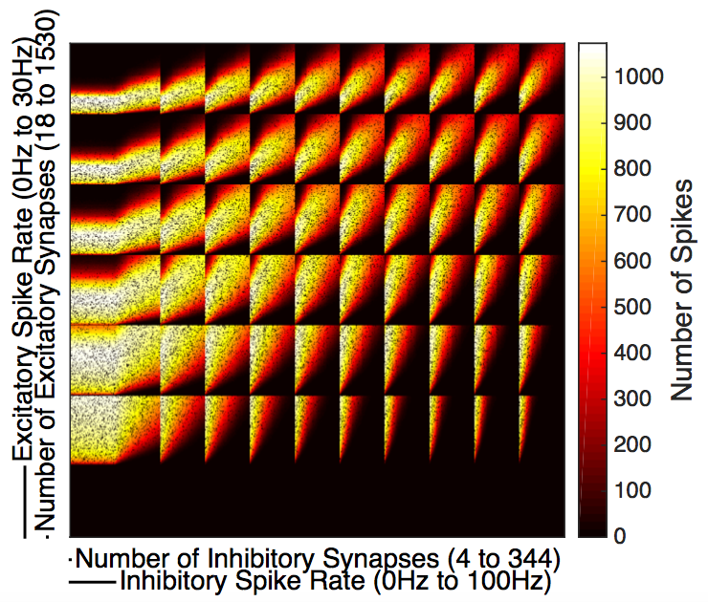
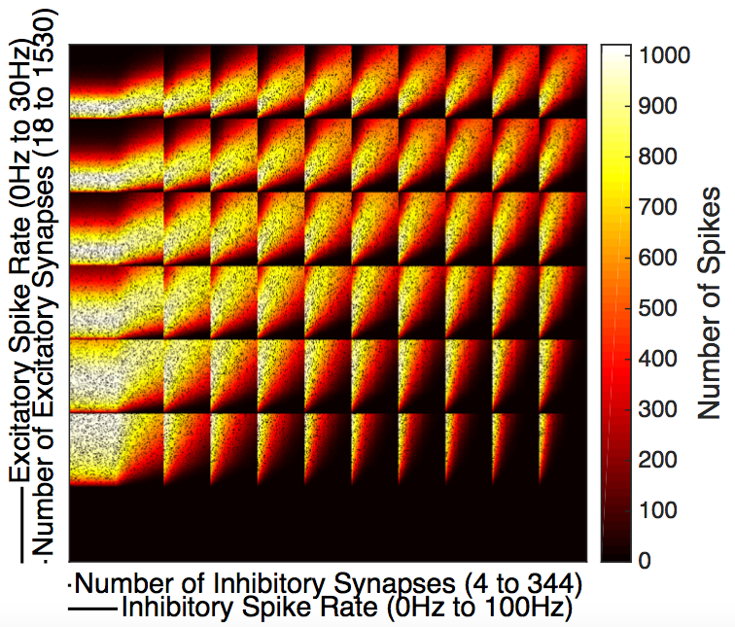
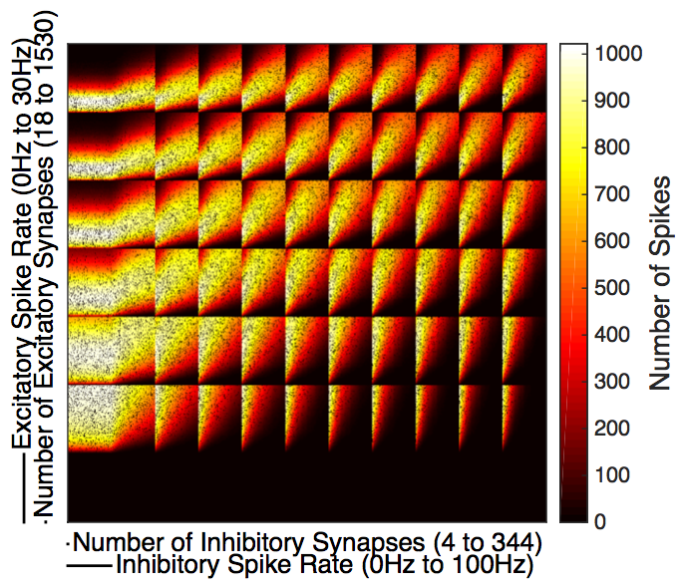
Independent Excitatory & Independent Inhibitory
Independent Excitatory & Common Inhibitory
Common Excitatory & Independent Inhibitory
Common Excitatory & Common Inhibitory
SDprox1
SDprox2

